Slide 1
IPL MATCH
BIDDING APP
CASE STUDY
Presented by - Group 6
vishwas HK
Tiyab goshe
Rajshekar
Subhash Chandra Bosh

Slide 2
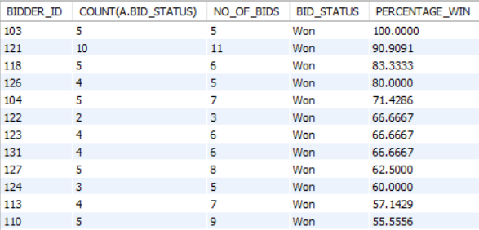
1. Show the percentage of wins of each bidder in the order of highest to lowest percentage
Query:
SELECT A.BIDDER_ID, COUNT(A.BID_STATUS), NO_OF_BIDS,A.BID_STATUS, (COUNT(A.BID_STATUS)/NO_OF_BIDS)* 100 AS ‘PERCENTAGE_WIN’ FROM IPL_BIDDING_DETAILS A
INNER JOIN IPL_BIDDER_POINTS B
ON A.BIDDER_ID = B.BIDDER_ID
AND A.BID_STATUS ='WON’
GROUP BY A.BIDDER_ID, NO_OF_BIDS
ORDER BY PERCENTAGE_WIN DESC;
Output:
Approach:
JOINS
AGGREGATE FUNCTIONS
Tables Used:
IPL_BIDDER_DETAILS
IPL_BIDDING_DETAILS
IPL_BIDDER_ POINTS
Result:
The percentage of wins for each bidder in descending order of 27 rows is returned.

Slide 3
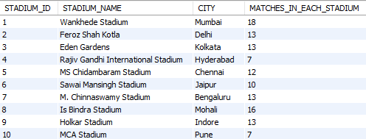
2. Display the number of matches conducted at each stadium with stadium name, city from the database
Query:
SELECT A.STADIUM_ID,A.STADIUM_NAME,A.CITY,
COUNT(B.STADIUM_ID) AS ‘MATCHES_IN_EACH_STADIUM’ FROM IPL_STADIUM A
LEFT JOIN IPL_MATCH_SCHEDULE B
ON A.STADIUM_ID = B.STADIUM_ID
GROUP BY A.STADIUM_ID;
Output:
Approach:
JOINS
AGGREGATE FUNCTIONS
Tables Used:
IPL STADIUM
IPL MATCH SCHEDULE
Result:
The number of matches conducted in each stadium with stadium name and city of 10 rows is returned.

Slide 4
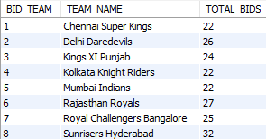
4. Show the total bids along with bid team and team name
Approach:
JOINS
AGGREGATE FUNCTION
Tables Used:
IPL_BIDDING_DETAILS
IPL_TEAM
Result:
The total bids with respect to bidding team and team names of 8 rows is returned.
Query:
SELECT A.BID_TEAM,B.TEAM_NAME,
COUNT(A.BID_TEAM) AS TOTAL_BIDS
FROM IPL_BIDDING_DETAILS A
JOIN IPL_TEAM B
ON A.BID_TEAM = B.TEAM_ID
GROUP BY A.BID_TEAM
ORDER BY A.BID_TEAM;
Output:

Slide 5
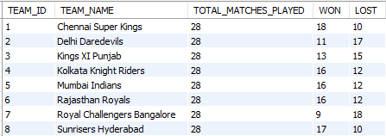
6. Display total matches played, total matches won and total matches lost by team along with its team name.
Approach:
JOINS
AGGEGTION FUNCTIONS
Tables Used:
IPL_TEAM_STANDINGS
IPL_TEAM
Result:
Returns total matches played, won and lost along with their team names by 8 rows.
Query:
SELECT A.TEAM_ID,B.TEAM_NAME,
SUM(A.MATCHES_PLAYED) AS ‘TOTAL_MATCHES_PLAYED’,
SUM(A.MATCHES_WON) AS ‘WON’,
SUM(A.MATCHES_LOST) AS ‘LOST’
FROM IPL_TEAM_STANDINGS A
JOIN IPL_TEAM B
ON A.TEAM_ID = B.TEAM_ID
GROUP BY A.TEAM_ID;
Output:

Slide 6
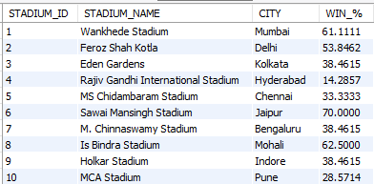
3. In a given stadium, what is the percentage of wins by a team which has won the toss?
Query:
SELECT A.STADIUM_ID,A.STADIUM_NAME,A.CITY,
(SELECT COUNT(*)
FROM IPL_MATCH B
JOIN IPL_MATCH_SCHEDULE C
ON B.MATCH_ID = C.MATCH_ID
WHERE B.TOSS_WINNER = B.MATCH_WINNER
AND C.STADIUM_ID=A.STADIUM_ID) /
(SELECT COUNT(*)
FROM IPL_MATCH_SCHEDULE C
WHERE C.STADIUM_ID = A.STADIUM_ID)
* 100 AS 'WIN_%’
FROM IPL_STADIUM A;
Output:
Approach:
SUB-QUERY
JOINS INSIDE SUBQUERY
Tables Used:
IPL_STADIUM
IPL_MATCH_SCHEDULE
IPL_STADIUM
Result:
The percentage of wins by the team who won the toss for given stadium with 10 rows is returned.

Slide 7
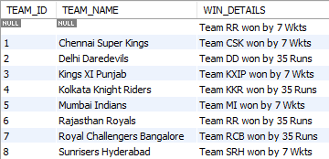
5. Show the team id who won the match as per the win details.
Approach:
JOINS
CASE WHEN STATEMENTS
Tables Used:
IPL_TEAM
IPL_MATCH
Result:
The result is based on team id’s who won the matches w.r.t winning details is returned by 8 rows.
Query:
SELECT A.TEAM_ID,B.TEAM_NAME,A.WIN_DETAILS FROM(SELECT CASE WHEN
MATCH_WINNER='1' THEN TEAM_ID1
WHEN MATCH_WINNER='2' THEN TEAM_ID2
END AS TEAM_ID,WIN_DETAILS
FROM IPL_MATCH) A
LEFT JOIN
(SELECT TEAM_ID,TEAM_NAME
FROM IPL_TEAM) B
ON A.TEAM_ID = B.TEAM_ID
GROUP BY A.TEAM_ID
ORDER BY A.TEAM_ID;
Output:

Slide 8
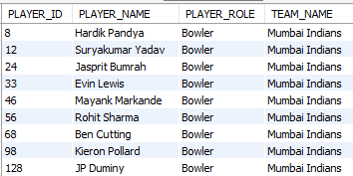
7. Display the bowlers for Mumbai Indians team.
Approach:
JOINS
Tables Used:
IPL_TEAM_PLAYERS
IPL_PLAYER
IPL_TEAM
Result:
This shows us the bowlers from team Mumbai Indians with respect to their player id by 9 rows.
Query:
SELECT A.PLAYER_ID,B.PLAYER_NAME,
A.PLAYER_ROLE,C.TEAM_NAME
FROM IPL_TEAM_PLAYERS A
JOIN IPL_PLAYER B
ON A.PLAYER_ID = B.PLAYER_ID
JOIN IPL_TEAM C
ON A.TEAM_ID = C.TEAM_ID
WHERE A.PLAYER_ROLE = 'BOWLER’
AND C.TEAM_NAME='Mumbai Indians’;
Output:

Slide 9
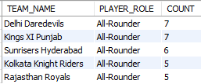
8. How many all-rounders are there in each team, display the teams with more than 4 all-rounders in descending order.
Query:
SELECT C.TEAM_NAME,A.PLAYER_ROLE,
COUNT(A.PLAYER_ROLE) AS COUNT
FROM IPL_TEAM_PLAYERS A
JOIN IPL_PLAYER B
ON A.PLAYER_ID=B.PLAYER_ID
JOIN IPL_TEAM C
ON A.TEAM_ID=C.TEAM_ID
WHERE A.PLAYER_ROLE = 'ALL-ROUNDER’
GROUP BY C.TEAM_NAME
HAVING COUNT > 4
ORDER BY COUNT DESC;
Output:
Approach:
JOINS
Tables Used:
IPL_TEAM_PLAYERS
IPL_PLAYER
IPL_TEAM
Result:
Returns the number of all rounder players who have more than 4 players in each team in descending order by5 rows.

